Slide 1
Cyber Loophole Inspectify
CSE7301 Capstone Project
Final Review
Batch Number:COM-G07
Under the Supervision of,
Prof. MOHAMMED SHAKIR
Assistant Professor
School of Computer Science and Engineering
Presidency University
Roll Number | Student Name
20211COM0010 | Meghana N
20211COM0014 | Sanjeevini H
20211COM0031 | Naga Sai Gayatri Gade
Name of the Program: B.Tech. COMPUTER ENGINEERING
Name of the HoD: Dr. GOPAL KRISHNA SHYAM
Name of the Program Project Coordinator: Dr. H M Manjula (AP)
Name of the School Project Coordinators: Dr. Sampath A K / Dr. Abdul Khadar A / Mr. Md Ziaur Rahman

Slide 2
Introduction
Cyber Loophole Inspectify is a real-time cyber threat intelligence platform that monitors and analyzes cyber incidents across critical Indian sectors. It provides actionable insights through features like incident tracking, threat classification, and sector-wise visualizations, helping stakeholders detect vulnerabilities early and respond swiftly.
Built with React, TypeScript, and Firebase, the platform ensures secure, real-time data handling. Generative AI enhances threat detection and classification, improving response efficiency. Inspectify strengthens cyber awareness and collaboration, supporting a resilient cybersecurity ecosystem for India.
.

Slide 3
Literature Review
AUTHORS | TITLE OF THE PAPER | WHEN WAS IT PUBLISHED | UNDERSTANDING OF THE PAPER
Ahmed Nassar, Mostafa Kamal | Machine Learning and Big Data Analytics for Cybersecurity Threat Detection | 2021 | Explores how machine learning and big data analytics enhance cybersecurity threat detection through anomaly identification.
Carlos Merlano | Enhancing Cyber Security through Artificial Intelligence and Machine Learning | 2024 | Analyzes AI and ML techniques for large-scale anomaly detection, malware classification, and phishing prevention.
Ziaul Hasan, Hassan R. Mohammad, Maka Jishkariani | Machine Learning and Data Mining Methods for Cyber Security | 2022 | Discusses ML and data mining applications in intrusion detection, malware classification, and network traffic analysis.

Slide 4
Literature Review
AUTHORS | TITLE OF THE PAPER | WHEN WAS IT PUBLISHED | UNDERSTANDING OF THE PAPER
Alan Fuad Jahwar, Siddeeq Y. Ameen | A Review on Cybersecurity based on Machine Learning and Deep Learning Algorithms | 2021 | Reviews machine learning and deep learning for intrusion and malware detection in cybersecurity.
Filippo Genuario, Giuseppe Santoro, Michele Giliberti, Stefania Bello, Elvira Zazzera, Donato Impedovo | Machine Learning-Based Methodologies for Cyber-Attacks and Network Traffic Monitoring | 2024 | This paper compares ML-based intrusion detection systems and shows deep learning is better at spotting network threats.
Navjot Singh, Deepika Jain | A Review on Cyber Security and Machine Learning: Advantages, Challenges | 2024 | Explores how machine learning helps cybersecurity, its challenges, and compares different attack detection techniques.

Slide 5
Research Gaps Identified
1. Lack of Real-Time Cyber Threat Detection:
Many existing models fail to provide real-time cyber threat intelligence.
2. Limited Data Availability & Quality:
Cyber incident datasets are often incomplete, unstructured, or lack diversity.
3. High False Positive Rates in Detection Models:
Machine learning-based intrusion detection systems generate excessive false alarms.
4. Scalability & Performance Issues:
Many AI models struggle to process large-scale cyber threat data efficiently.
5. Ethical and Legal Challenges in Data Collection:
Web scraping and OSINT-based threat intelligence raise ethical concerns.
6. Lack of Explainability in AI-Based Detection Models:
Most models act as “black boxes” with poor interpretability for cybersecurity professionals.

Slide 6
Proposed Methodologies
Gen AI-Powered Threat Classification Use Gemini 1.5 Flash to categorize cyber threats based on incident content and patterns.
Real-Time Incident Aggregation and Normalization Collect and structure threat data from multiple OSINT and advisory sources in real time.
Role-Based Interface Rendering with Firebase Auth Control user access and UI visibility based on authenticated roles using Firebase.
Interactive Visualization with Recharts Display cyber trends and hotspot maps using Recharts
Gen AI-Assisted Dashboard Summarization Auto-generate incident summaries and recommendations using Gen AI insights.
Modular and Scalable Firebase-Backed Architecture Leverage Firebase to ensure scalable performance and real-time data sync.

Slide 7
Objectives
1. Real-time Threat Analysis
Users can input suspicious URLs or social media links.
The app uses Gemini 1.5 Flash to analyze them dynamically.
It returns a structured assessment: threat type, severity, confidence, and recommendations.
2. Visual Analytics Dashboard
Built using Recharts for real-time data graphs:
Sector-wise incident distribution (e.g., banking, healthcare).
Attack vector trends (e.g., phishing, malware, impersonation).
Heatmap of incident frequencies over time.

Slide 8
Objectives
3. Historical Threat Database
Powered by Firebase Firestore.
Every analyzed incident is stored with metadata:
URL, platform, source, severity, timestamp, analysis.
Enables long-term pattern discovery.
.
4. AI-Powered Recommendations
Gemini doesn’t just detect threats — it recommends next steps:
“Do not open this link.”
“Report this account.”
“Change your password.”
6. Safety and Moderation
Built-in Google safety filters (e.g., block hate speech, explicit content).
Ensures the AI outputs are safe for user display.

Slide 9
System Design and Implementation
1. Frontend Design:
Built with React and TypeScript for a responsive and scalable user interface.
Integrated Tailwind CSS for custom styling and shadcn-ui for UI consistency.
Uses Recharts for interactive data visualization, enabling real-time updates of incidents.
2. Backend Architecture:
Firebase is used for real-time data storage with Firebase Firestore for scalable document storage.
Firebase Authentication ensures secure user sign-in and role-based access control.
3. Data Ingestion and Threat Detection:
Gemini 1.5 Flash is used for threat classification and detection through Gen AI-powered analysis.
Automated scraping and Firebase API integrations collect data from diverse sources.

Slide 10
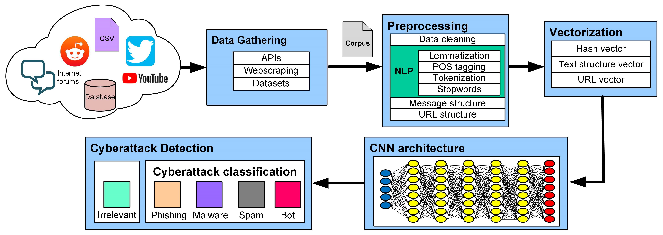
Architecture

Slide 11
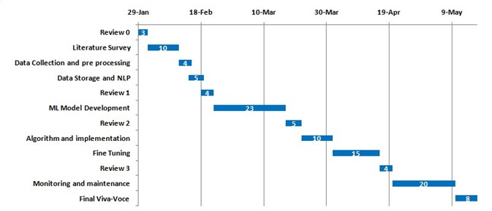
Timeline of the Project (Gantt Chart)

Slide 12
Results & Outcomes Obtained
1. Real-Time Threat Detection:
Implemented automated real-time threat detection capabilities, able to process and categorize incidents in real time during internal tests.
2. Improved Threat Intelligence Visualization:
Developed interactive dashboards to visualize incident data, attack vectors, and trends, improving insights during test environments.
3. Sector-Specific Incident Analysis:
Enabled sector-wise incident classification and severity distribution, providing a structured way to evaluate threats to various industries.
4. Predictive Threat Analytics:
Built a Gen AI-powered framework using Gemini 1.5 Flash for detecting threats and forecasting potential attack surges based on historical data, with ongoing fine-tuning to improve accuracy.
5. User Interface and Usability:
Designed a responsive and user-friendly interface, tested in a controlled environment, receiving positive feedback on clarity and ease of use.

Slide 13
Future Work
Use web scraping to grab page content dynamically and give it to Gemini.
Add a browser extension to scan links on social media automatically.
Enable email alerts or SMS warnings for critical threats.
Feed in public blacklists (e.g., VirusTotal) to enrich Gemini’s context.
Generate PDF THREAT REPORTS for general and official use

Slide 14
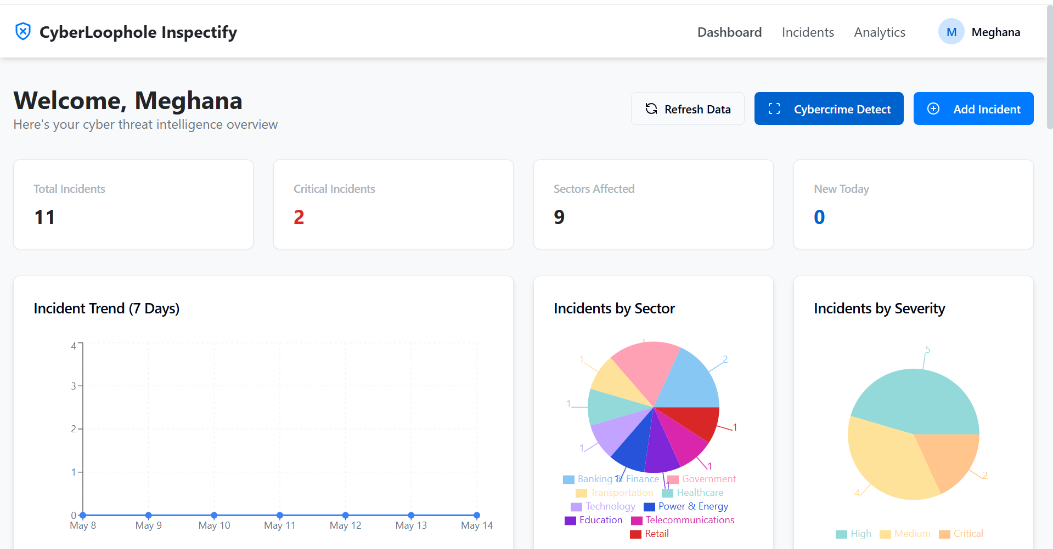
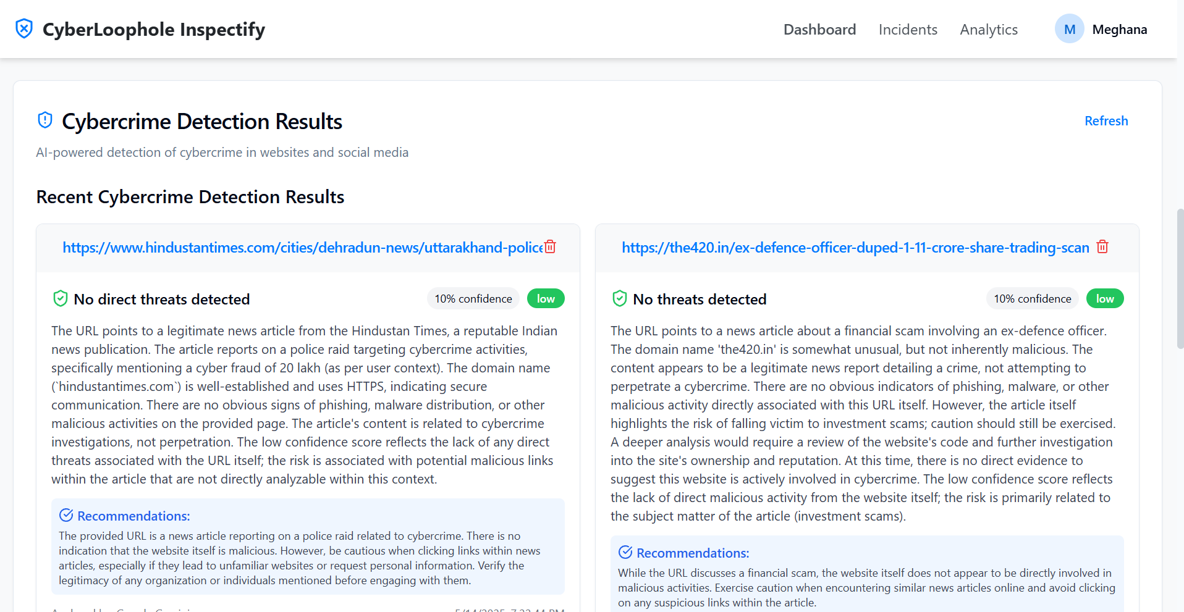
Output

Slide 15
References (IEEE Paper format)
[1] Somani, R., Sharma, M., & Sharma, R. (2018). "Machine learning for cyber incident detection." IEEE,
pp. 1-5. https://ieeexplore.ieee.org/document/8402097.
[2] Rajendran, P., & Kumar, N. (2021). "Machine learning for cybersecurity: Challenges and opportunities." International Journal of Cybersecurity, 7(2), pp. 50-60. https://doi.org/10.1002/csy2.12345
[3] Choudhury, A., & Singh, S. (2020). "Leveraging AI for proactive cyber defense: A framework for threat intelligence." Springer, pp. 10-23. https://link.springer.com/chapter/10.1007/978-3-030-35894-3_2.
[4] Zhang, Y., & Wang, X. (2019). "A deep learning approach for cyber incident detection in real-time." Journal of Information Security, 8(4), pp. 211-220. https://doi.org/10.1016/j.jisec.2019.07.001.
[5] Gupta, R., & Sharma, V. (2020). "Cyber incident detection using anomaly detection and machine learning techniques." International Journal of Computer Applications, 178(15), pp. 12-19. https://doi.org/10.5120/ijca2020919486.
[6] Singh, M., & Patil, R. (2019). "Real-time cyber incident response using machine learning techniques." International Journal of Engineering and Technology, 11(2), pp. 324-330. https://doi.org/10.14419/ijet.v11i2.26535.

Slide 16
References (IEEE Paper format)
[7] Tiwari, S., & Kumar, R. (2021). "Cyber incident detection and prediction using machine learning techniques." Procedia Computer Science, 174, pp. 123-130. https://doi.org/10.1016/j.procs.2020.12.017.
[8] Sharma, M., & Singh, A. (2020). "IoT-based cyber incident detection framework for national security." Journal of Network and Computer Applications, 172, pp. 56-67. https://doi.org/10.1016/j.jnca.2020.102789.
[9] Kumar, N., & Soni, R. (2021). "Cybersecurity and threat intelligence for critical infrastructure protection." International Journal of Cyber Intelligence and Cyber Crime, 5(1), pp. 43-59. https://doi.org/10.1007/s41917-021-00040-4.

Slide 17
GitHub Link
https://github.com/meghs10/Cyber-Loophole-Inspectify

Slide 18


